Slide 1
Introduction to Graphs

Slide 2
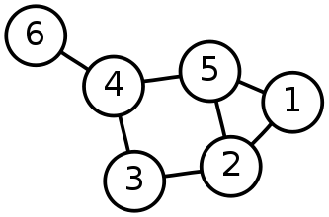
Undirected graph
V = {1, 2, 3, 4, 5, 6}
E = {{1,2}, {1,5}, {2,3}, {2,5}, {3,4}, {4,5}, {4,6}}
A undirected graph is a pair G = (V, E) consisting of a set V of vertices together with a set E of edges, which are 2-element subsets of V.

Slide 3
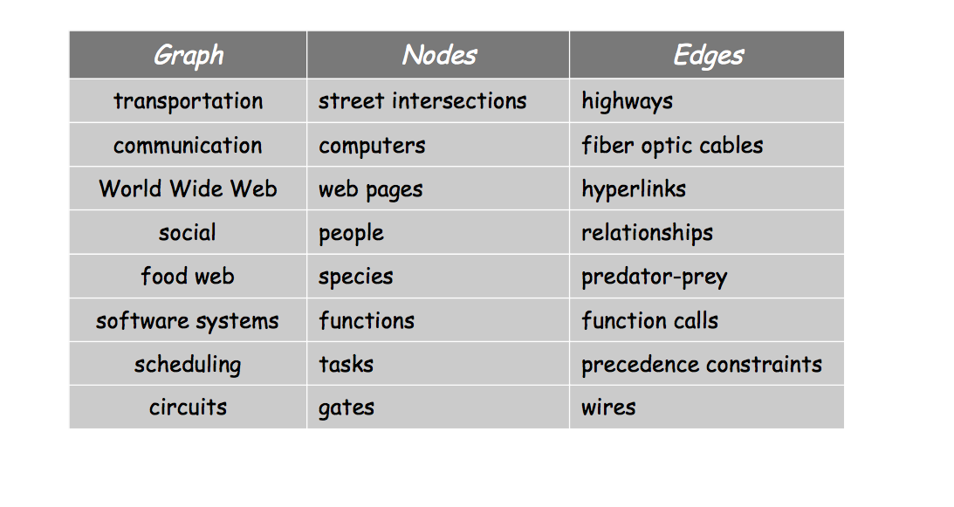
Examples of graphs

Slide 4
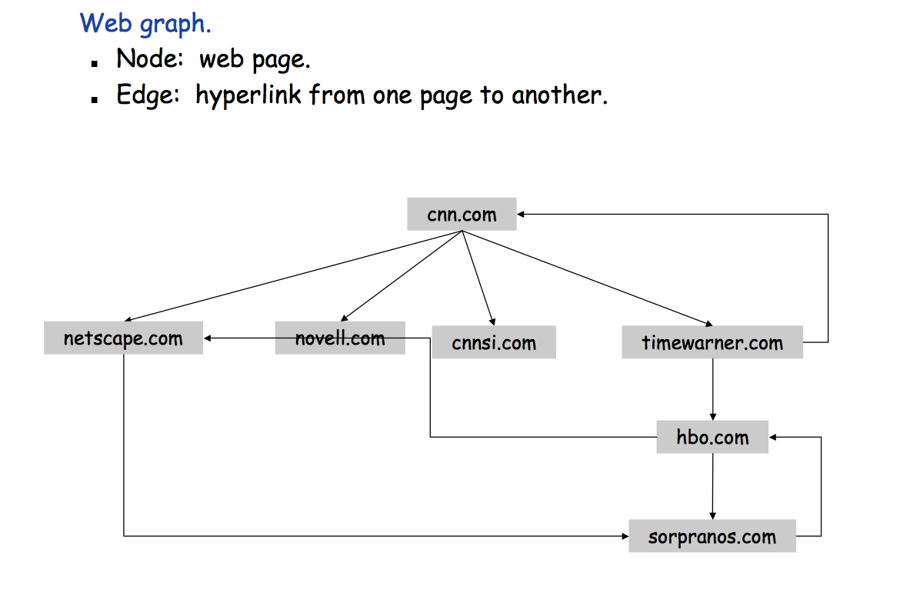
Web graph

Slide 5
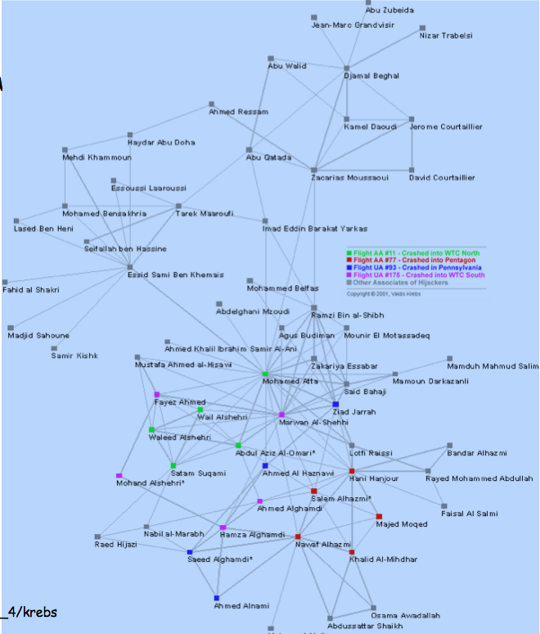
9-11 Terrorist network

Slide 6
Terminology
A simple graph is an undirected graph that has no loops and no more than one edge between any two distinct vertices.
The order of a graph is (the number of vertices).
A graph's size is , the number of edges.
is the maximum number of edges
The degree of a vertex is the number of edges that connect to it.

Slide 7
Example
V = {1, 2, 3, 4, 5, 6}
E = {{1,2}, {1,5}, {2,3}, {2,5}, {3,4}, {4,5}, {4,6}}
|V| = 6 |E| = 7
deg(1) = 2 deg(2) = 3
deg(3) = 2
deg(4) = 3 deg(5) = 3 deg(6) = 1

Slide 8
Terminology
An undirected graph’s density is defined to be

Slide 9
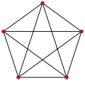
Complete graphs
K_{n}
K₅ – complete graph on 5 vertices
The complete graph on n vertices, denoted by K_{n}, is an undirected graph in which every pair of vertices is connected by an edge.
|V| = 5, |E| = 10

Slide 10
Example
|V| = 6 and |E| = 7
|V| = 5 and |E| = 10

Slide 11
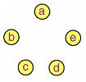
Empty graphs
N₅ – null graph on 5 vertices
The empty or null graph on n vertices, denoted by N_{n}, is an undirected graph with no edges.
|V| = 5, |E| = 0

Slide 12
Cycle graphs
C₅ – cycle on 5 vertices
The cycle graph on n vertices, denoted by C_{n}, is an undirected graph consisting on an n-cycle.
|V| = 5, |E| = 5

Slide 13
Combining Graphs
Union
Example
Let G₁ = (V₁, E₁) and G₂ = (V₂, E₂) be graphs. The union of G₁ and G₂, denoted G₁ G₂, has vertex set V₁ V₂ and edge set E₁ E₂.
4
1
0
2
3
G₁ U G₂
G₁
G₂

Slide 14
Combining Graphs
Join
Example
Let G₁ = (V₁, E₁) and G₂ = (V₂, E₂) be graphs. The join of G₁ and G₂, denoted G₁ + G₂, has vertex set V₁ V₂ and edge set E₁ E₂ V₁xV₂ .
2
4
1
3
0
G₁
G₂
G₁ + G₂

Slide 15
Combining Graphs
Product
Example
Let G₁ = (V₁, E₁) and G₂ = (V₂, E₂) be graphs. The product of G₁ and G₂, denoted G₁ x G₂, has vertex set V₁ x V₂ and edge set defined as follows: (u₁,u₂) is adjacent to (v₁,v₂) if and only if either u₁=v₁ and u₂ is adjacent to v₂ or u₂=v₂ and u₁ is adjacent to v₁.
2
03
4
13
23
1
14
24
3
0
04
G₁
G₂
G₁ x G₂

Slide 16
Combining Graphs
Composition
Example
Let G₁ = (V₁, E₁) and G₂ = (V₂, E₂) be graphs. The composition of G₁ and G₂, denoted G₁[G₂], has vertex set V₁ x V₂ and edge set defined as follows: (u₁,u₂) is adjacent to (v₁,v₂) if and only if either u₁ is adjacent to v₁ or u₁=v₁ and u₂ is adjacent to v₂.
03
2
4
13
23
1
14
24
3
04
0
G₁
G₂
G₁[G₂]

Slide 17
Combining Graphs
Kronecker Product
Example
Let G₁ = (V₁, E₁) and G₂ = (V₂, E₂) be graphs. The product of G₁ and G₂, denoted G₁ • G₂, has vertex set V₁ x V₂ and edge set defined as follows: (u₁,u₂) is adjacent to (v₁,v₂) if and only if u₁ is adjacent to v₁ and u₂ is adjacent to v₂.
2
03
4
13
23
1
14
24
3
0
04
G₁
G₂
G₁ • G₂

Slide 18
Complement of a graph
Example
Let G = (V, E) be a graph. The complement of G, denoted by G^{c}, is the graph on the same vertex set consisting of all edges that do not belong to G.
1
1
2
5
2
5
3
4
3
4
G
G^{c}

Slide 19
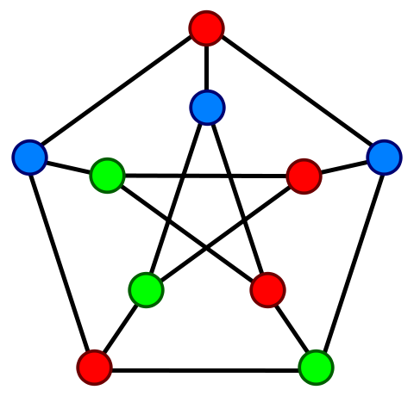
Vertex coloring
Petersen graph
A vertex coloring is a way of coloring the vertices of a graph such that no two adjacent vertices share the same color.

Slide 20
Chromatic polynomial
Denoted by P(G, x)
P(K₅, x) = x(x-1)(x-2)(x-3)(x-4)
The chromatic polynomial of a graph G counts the number of possible vertex colorings of G using x distinct colors.
x
x-4
x-1
x-3
x-2
This vertex can be colored in x-3 ways
There are x ways to color this vertex
This vertex can be colored in x-2 ways
This vertex can be colored in x-4 ways
This vertex can be colored in x-1 ways

Slide 21
Complete graphs
The chromatic polynomial of the complete graph on n ≥1 vertices is P(K_{n}, x) = x(x-1)(x-2) … (x-n+1).

Slide 22
Empty graphs
Compute the chromatic polynomial of any empty graph (on board)

Slide 23
Empty graphs
The chromatic polynomial of the empty graph on n≥1 vertices is P(N_{n}, x) = x^{n}.

Slide 24
Chromatic number of a graph
The chromatic number of a graph is the smallest positive integer c such that the chromatic polynomial P(G, c) > 0.
The chromatic number of the Petersen graph is 3.

Slide 25
Fundamental Reduction Theorem
A recursive way of computing the chromatic polynomial is based on edge contraction: for a pair of adjacent vertices u and v the graph G_{uv} is obtained by merging the two vertices and removing the edge between them. Then the chromatic polynomial satisfies the recurrence relation P(G, x) = P(G − uv, x) − P(G_{uv}, x) where u and v are adjacent vertices and G − uv is the graph with the edge uv removed.
Use on graphs whose density is less than 1/2

Slide 26
Example
= −
= − − +
= − − + − +
= − 3 + 2
= x³ − 3x² + 2x

Slide 27
Fundamental Reduction Theorem
A recursive way of computing the chromatic polynomial is based on edge contraction: for a pair of non-adjacent vertices u and v the graph G_{uv} is obtained by merging the two vertices and adding the edge between them. Then the chromatic polynomial satisfies the recurrence relation P(G, x) = P(G + uv, x) + P(G_{uv}, x) where u and v are adjacent vertices and G + uv is the graph with the edge uv added.
Use on graphs whose density is greater than 1/2

Slide 28
Example
= +
= + + + = + 2 +
= x(x-1)(x-2)(x-3) + 2x(x-1)(x-2) + x(x-1)
= x⁴ – 4x³ + 6x² – 3x

Slide 29
Contraction caveats
2 3 2 3 24 3
5 5 5
1 = 1 6 1 4 7 6 4 7 7 6
24 3
5
1 6
7
The resulting graph may not be simple! You must remove duplicate edges
6
2
3
1
4
The nodes in the contracted graph must be renumbered
5

Slide 30
Representing graphs
Adjacency matrix A(G)
Example
0 1 0 0 1 0
1 0 1 0 1 0
0 1 0 1 0 0
0 0 1 0 1 1
1 1 0 1 0 0
0 0 0 1 0 0
The adjacency matrix A(G) for a graph G is a |V| x |V| matrix whose entry A_{uv} = 1 whenever {u,v} is an edge in G; otherwise, A_{uv} = 0.
|V| = 6, |E| = 7
Checking if {u,v} is an edge takes constant time
Identifying all edges takes Θ(|V|²)
O(|V|²) space

Slide 31
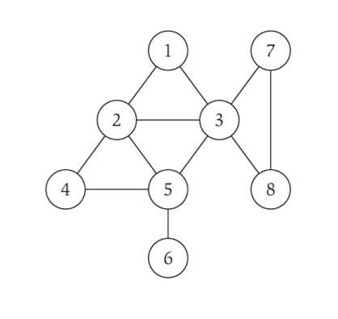
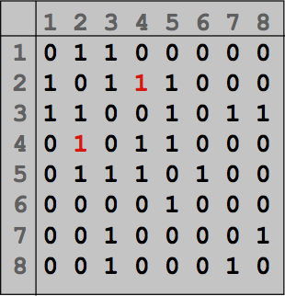
Practice problem
Find the density
Find the adjacency matrix representation

Slide 32
Representing graphs
Checking if {u,v} is an edge takes O(deg(u)) time
Identifying all edges takes Θ(|V| ⁺ |E|)
Adjacency list
Example
The adjacency list representation of a graph consists of lists one for each vertex , which gives all the vertices to which it is adjacent.
|V| = 6, |E| = 7
2
5
1
5
3
1
2
3
4
2
4
3
5
6
5
2
4
O(|V|²) space for graphs with density near 1
O(|E| + |V|) space for graphs with density near 0
1
6
4

Slide 33
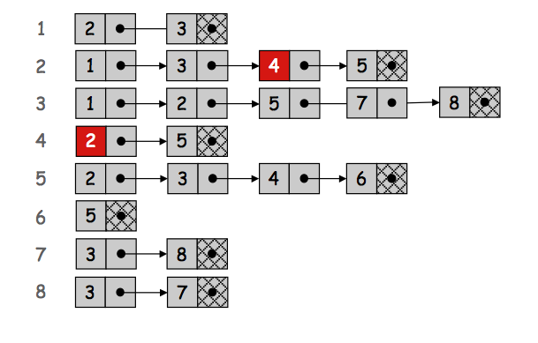
Practice problem
Find the degree of each vertex
Find adjacency list representation

Slide 34
Representing Graphs
One of many possibilities
Example
Using an integer to hold the number of vertices |V|
ArrayList<Edge> to hold the edges
|V| = 6,
Edges= {{1,2}, {1,5}, {2,3}, {2,5}, {3,4}, {4,5}, {4,6}}
Note: |E| = Edges.size()

Slide 35
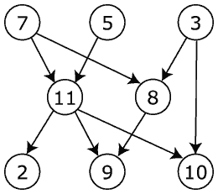
Directed graph
A directed graph is a pair G = (V, E) consisting of a set V of vertices together with a set E of edges, which are ordered pairs of vertices.

Slide 36
Weighted graph
A weighted graph is a graph in which each edge is assigned a numerical weight. The graph can either be directed or undirected.
5
3
2
A
D
E
H
3
4
2
4
C
B
G
F
2
4
3

Slide 37
Representing weighted graphs
Adjacency matrix
Weighted graph
A B C D E F G H
A 0 4 3 5 0 0 0 0
B 4 0 2 2 0 0 4 0
C 3 2 0 0 0 0 0 0
D 5 2 0 0 3 0 0 0
E 0 0 0 3 0 4 0 2
F 0 0 0 0 4 0 3 0 G 0 4 0 0 0 3 0 0 H 0 0 0 0 2 0 0 0
5
3
2
A
D
E
H
3
4
2
4
C
B
G
F
2
4
3

Slide 38
Representing weighted graphs
Adjacency list
Weighted graph
A
B 4
C 3
D 5
B
A 4
C 2
D 2
G 4
C
A 3
B 2
D
A 5
B 2
E 3
E
D 3
F 4
H 2
5
3
2
A
D
E
H
F
E 4
G 3
G
B 4
F 3
3
4
2
4
H
E 2
C
B
G
F
2
4
3

Slide 39
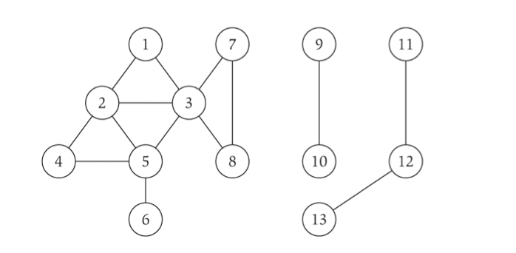
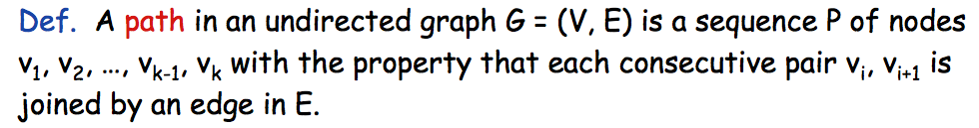
Paths and connectivity

Slide 40
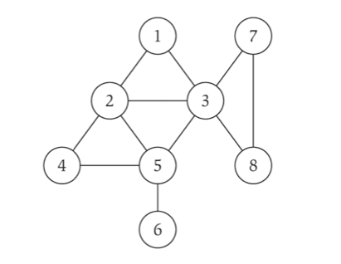

Cycles

Slide 41
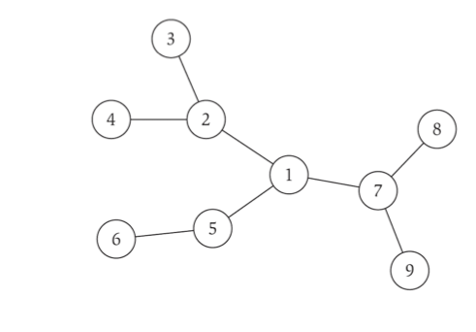
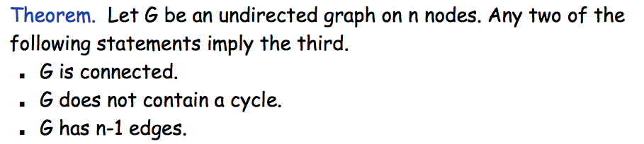
Trees

Slide 42
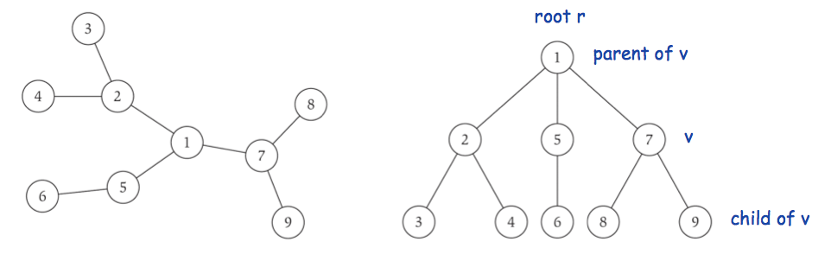
Rooted trees

Slide 43
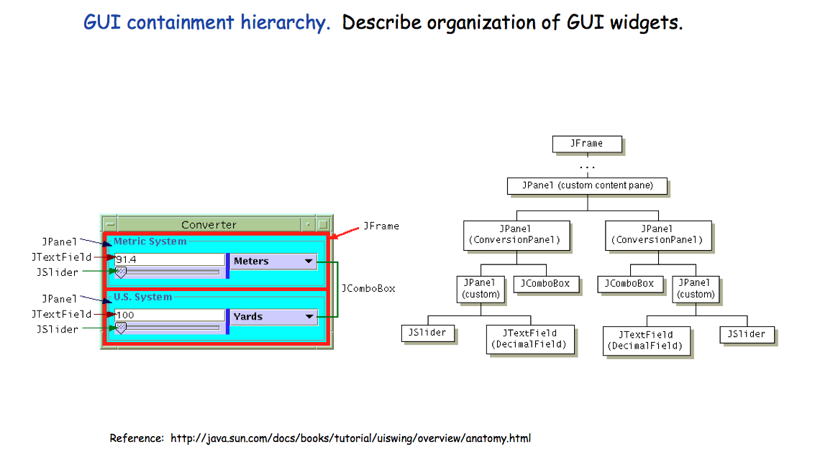
GUI containment hierarchy

